Slide 1
Music Generation Week 3

Slide 2
HELLO!
Agenda
Icebreakers / Announcements
Review
New content - NN and LTSM
Summary/HW

Slide 3
How ya’ll doin?

Slide 4
Review

Slide 5

Basic Idea Behind Machine Learning
Input
Input
Purpose-built
Code
Machine Learning Model
Output
Output
Program
Output

Slide 6
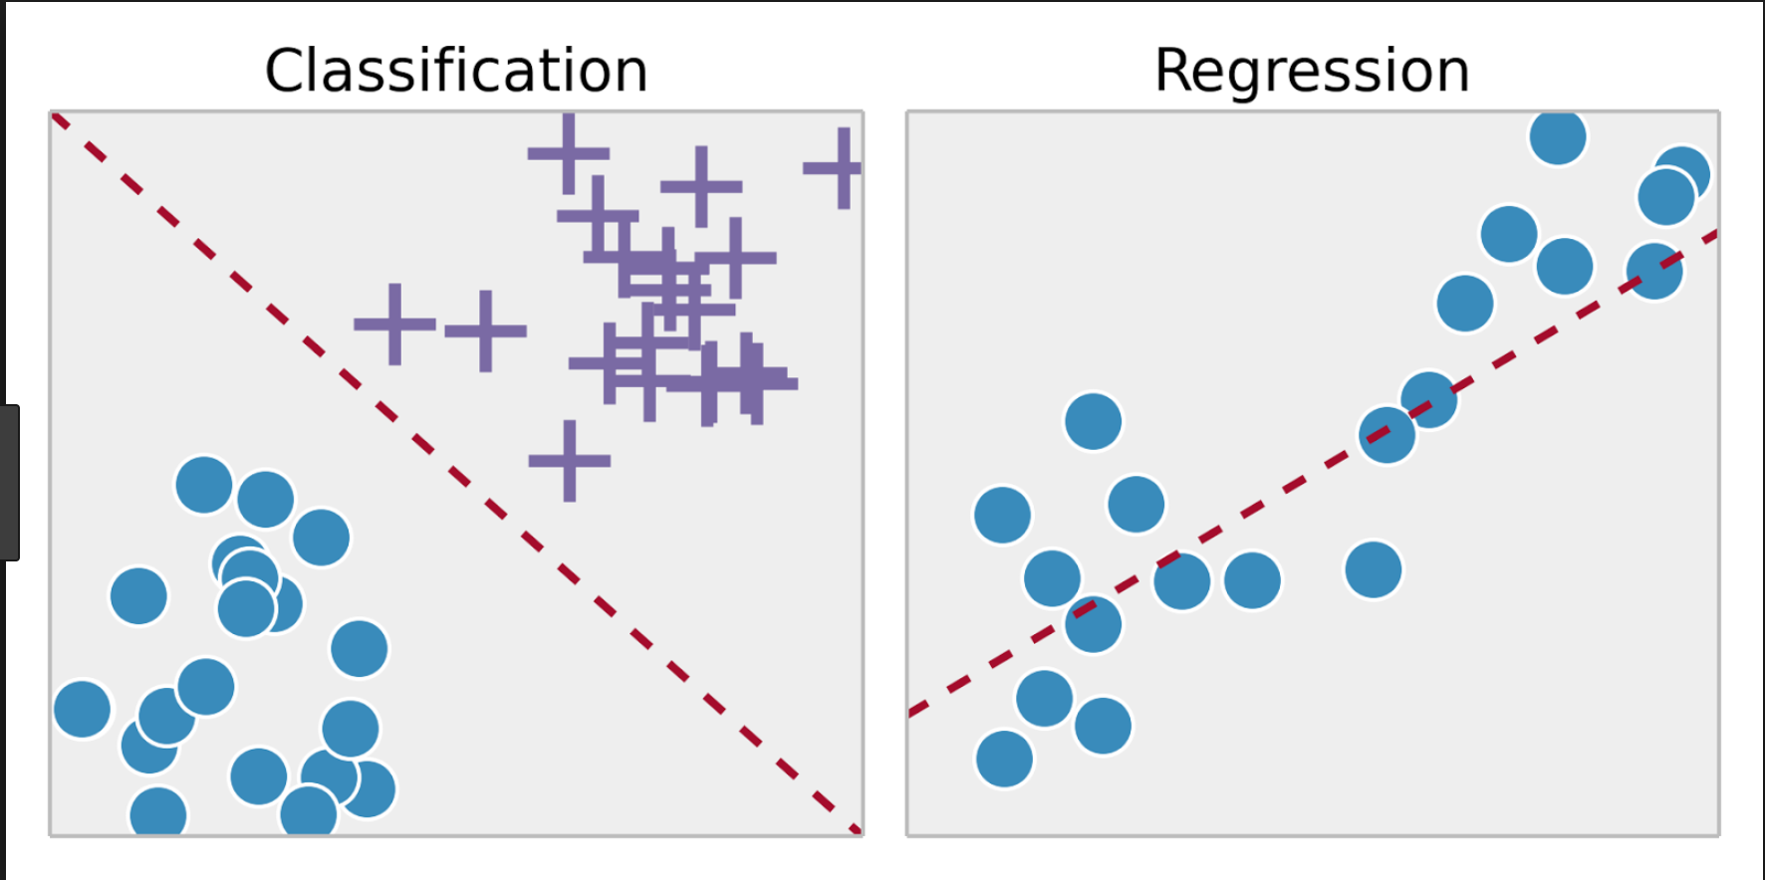
Classification vs Regression

Slide 7
New stuff
Let’s start with the first set of slides

Slide 8
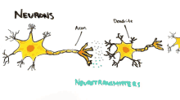
Neural Nets
What ideas does “neural nets” bring to mind?

Slide 9
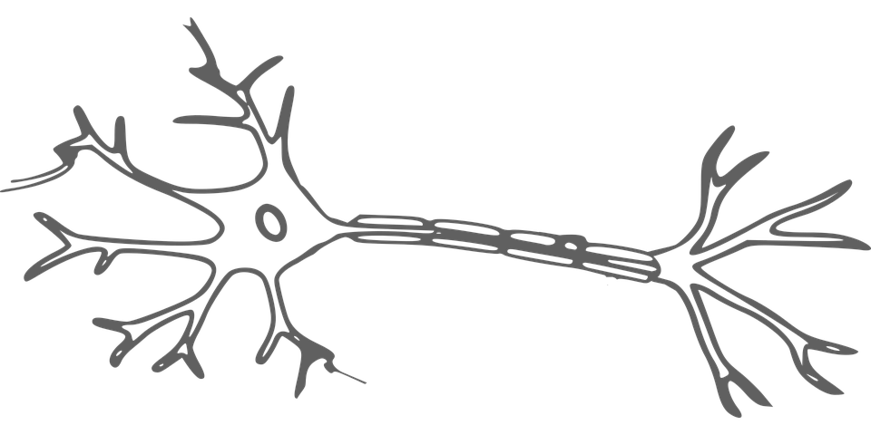
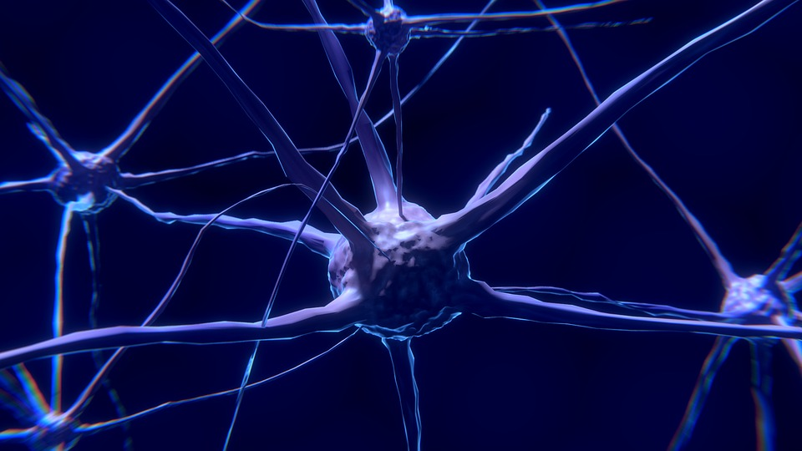
Neural Networks in Real Life
Conceptually, what are artificial neural networks?
A neuron receives a signal, processes it, and then propagates the signal (or not).
Artificial Neural Networks (ANNs) are very simple models of biological brain function / structure!

Slide 10
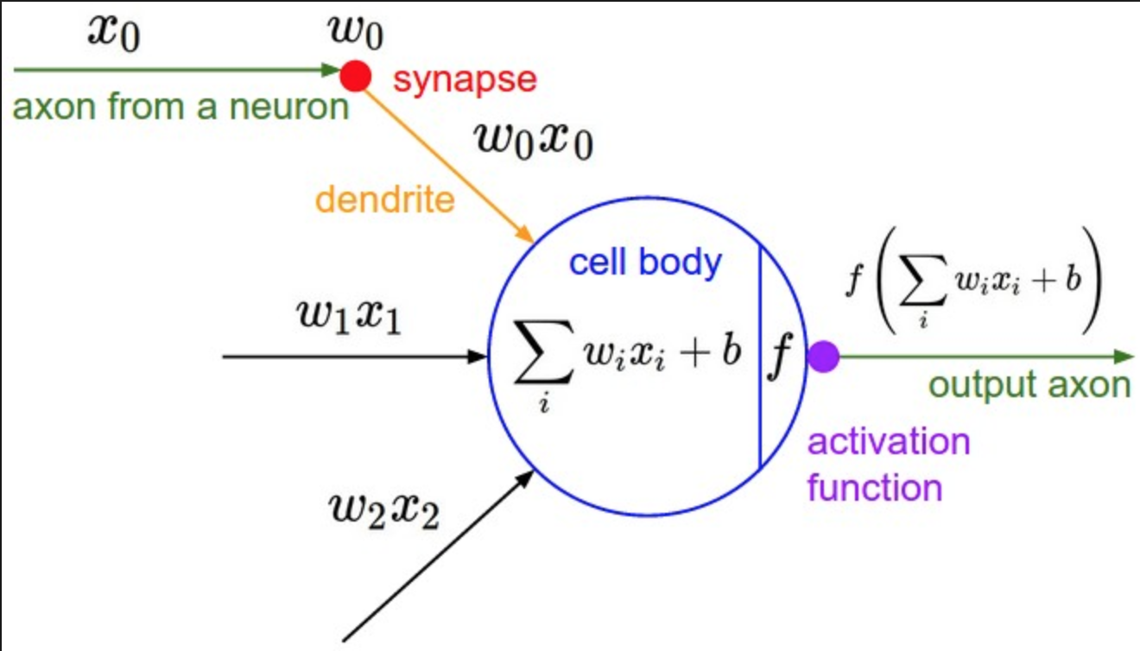
On a high level: Neuron = “Node” = apply a bunch of weights and functions to your data
…
σ^{n}
Notes:
ON A VERY HIGH LEVEL
Node just represent computation on input from the data with a set of coefficients/weights that amplify or dampen that input (assigning significance to features of the data)- just like how a neuron fires in the human brain when it encounters sufficient stimuli. -> e.g. which input is most helpful is classifying data without error? -> or what neurons information is most important to classifying the red fruit as an apple.
information is most important to classifying the red fruit as an apple.

Slide 11
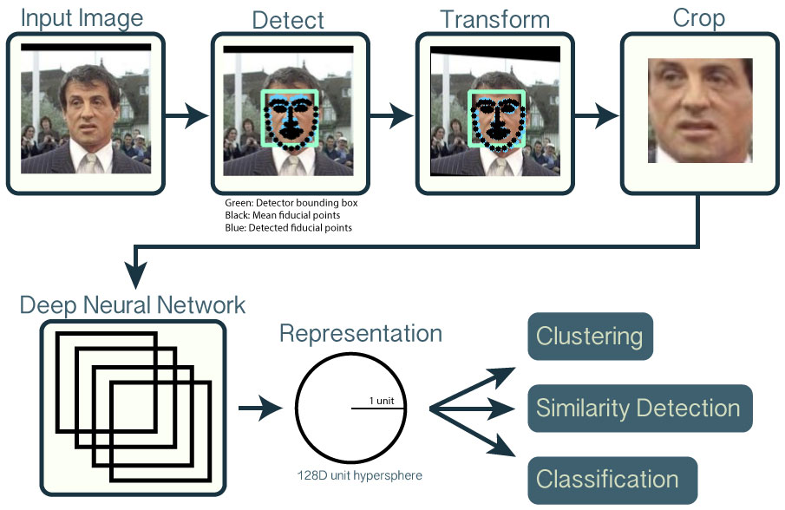
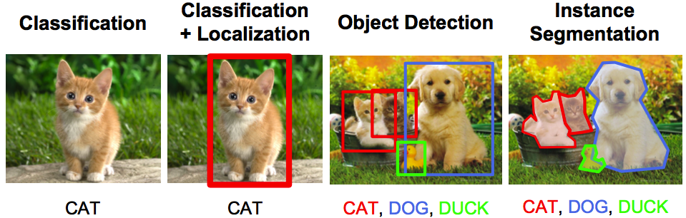
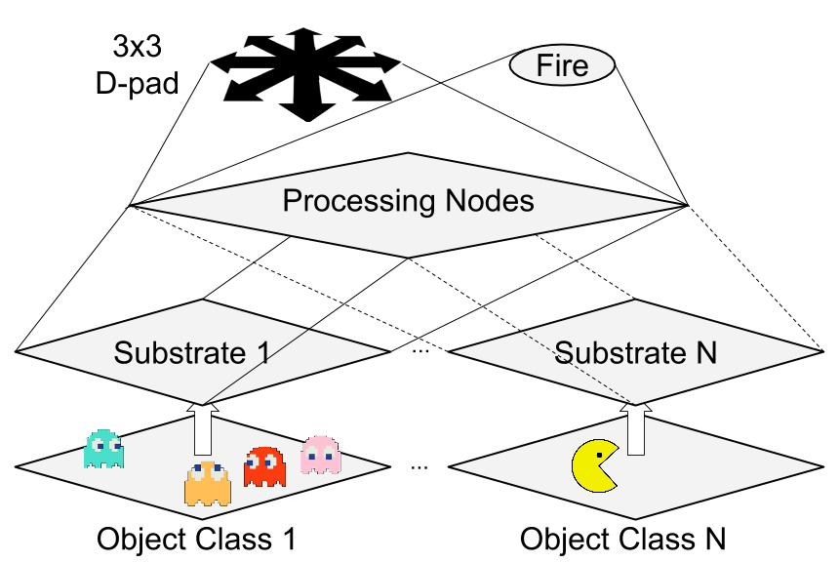
Applications of Neural Nets

Slide 12
Conceptual
Mathematical Model
In our model, a “neuron” will receive n signals from n sources. If each signal has a weight, w, then the output will be a weighted sum:
w¹
σ¹
…
w^{n}
Σ
f(Σ)
…
σ^{n}
Notes:
Make sure we expand on weights and activation function!
information is msost important to classifying the red fruit as an apple.

Slide 13
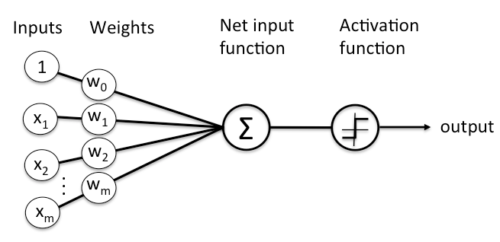
1. Data points (inputs) are weighted and summed together:
∑_{j} W_{j}ᐧX_{j}
2. That sum is passed through an activation function which outputs another number that determines how that signal gets propagated to other neurons
w¹
σ¹
…
w^{n}
Σ
f(Σ)
…
σ^{n}
Notes:
information is most important to classifying the red fruit as an apple.

Slide 14
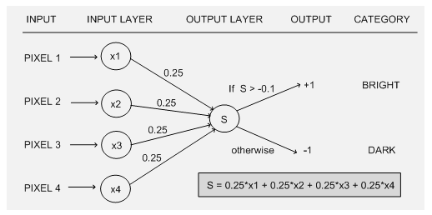
Example:
Perceptron (aka a single layer Neural Net that uses a step function for its activation fn)
Data
Data
Weighted Sum
Activation Fn
Notes:
information is most important to classifying the red fruit as an apple.

Slide 15
Step 1: Model Initialization
Let’s randomly initialize some weights that are all set to 3
Then our model is y = 3 * x
Data
Weighted Sum
Notes:
information is most important to classifying the red fruit as an apple.

Slide 16
Step 2: Forward Propagate
Our model is y = 3 * x . Let’s see what type of output we get using this model:
forward direction from the input -> through the neural network -> to the output.
Input (x) | Output (y)
0
1
2
3
4
Data
Weighted Sum
Notes:
information is most important to classifying the red fruit as an apple.

Slide 17
Step 3: Loss Function
Our model is y = 3 * x . Let’s see what type of output we get using this model:
forward direction from the input -> through the neural network -> to the output.
Input (x) | Output (y = 3 * x) | Desired | Abs. Error | Square Error
0
1
2
3
4
Data
Weighted Sum
Notes:
information is most important to classifying the red fruit as an apple.

Slide 18
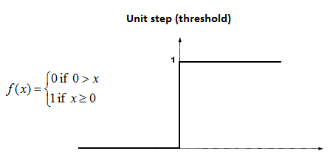
Example: Perceptron (aka a single layer Neural Net that uses a
step function for its activation fn)
Let’s set the activation function = step function
Weights are all 1/4 (Wn = 1/4)
Input Data | f(∑_{j} W_{j}ᐧX_{j}) | Output
(0, 8, 16) | Sum > 3
(5, 0, 0) | Sum _ 3
(-1, 8, 8) | Sum _ 3
(-2, 16, 16) | Sum _ 3
3 > x
3 < x
Notes:
information is most important to classifying the red fruit as an apple.

Slide 19
Example: Perceptron (aka a single layer Neural Net that uses a
step function for its activation fn)
Let’s set the activation function = step function
Weights are all 1/4 (Wn = 1/4)
Input Data | f(∑_{j} W_{j}ᐧX_{j}) | Output
(0, 8, 16) | Sum > 3 | 1
(5, 0, 0) | Sum < 3 | 0
(-1, 8, 8) | Sum > 3 | 1
(-2, 16, 16) | Sum > 3 | 1
3 > x
3 < x
Notes:
information is most important to classifying the red fruit as an apple.

Slide 20
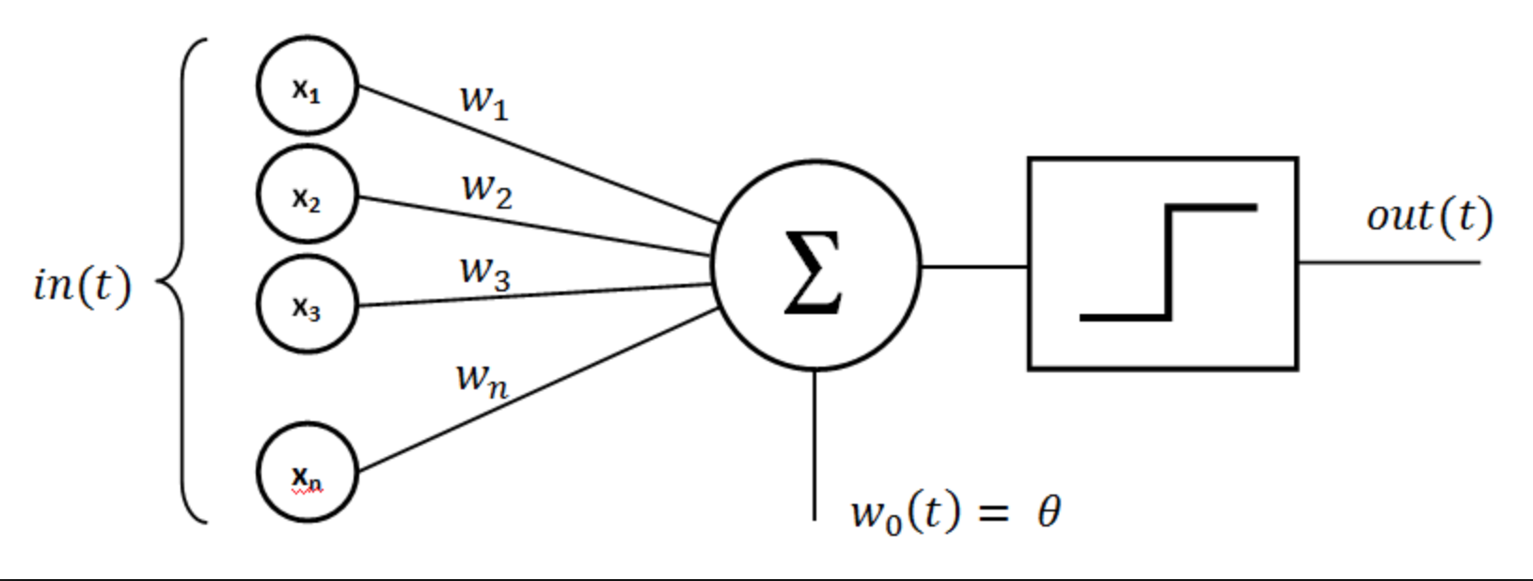
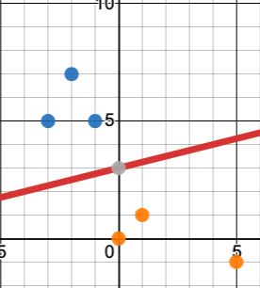
Another way to think of
Is like a line with slope m= 2 and a bias b = -3
Y = 1/4x + 3
Where everything below the line is given a 0 and everything above is given a 1
Notes:
information is most important to classifying the red fruit as an apple.

Slide 21
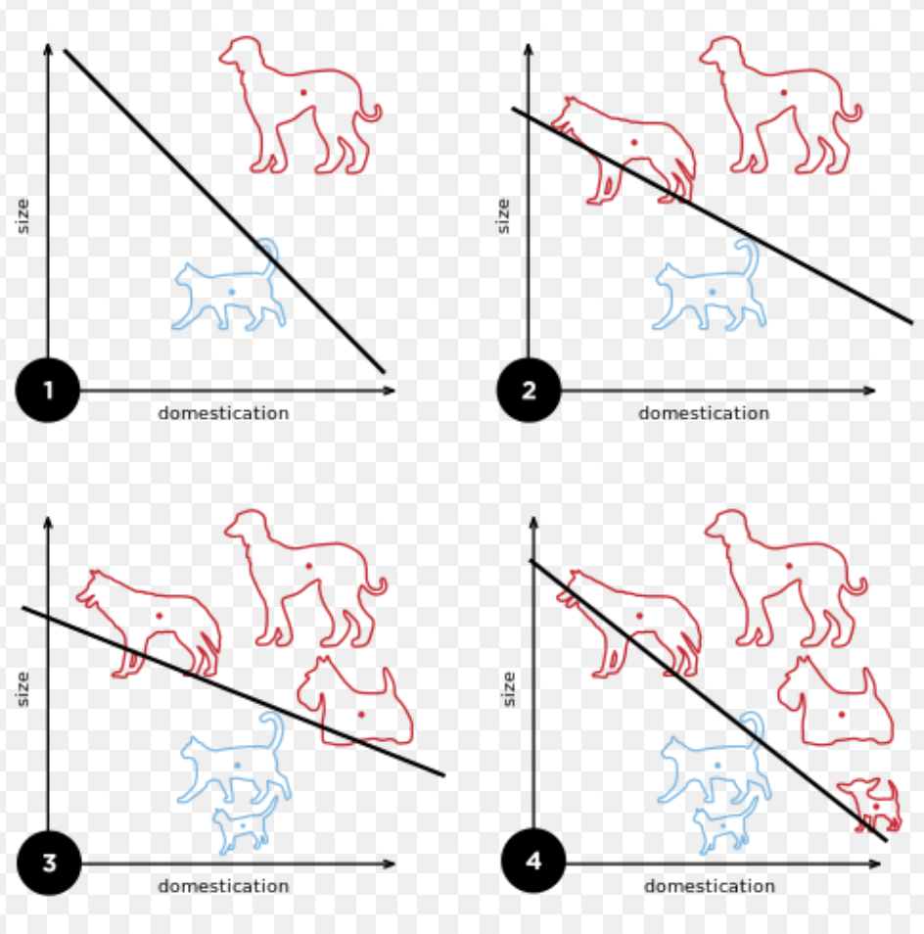
Example:
Or everything above the line is classified as a dog and everything below is a cat
Notes:
information is most important to classifying the red fruit as an apple.

Slide 22
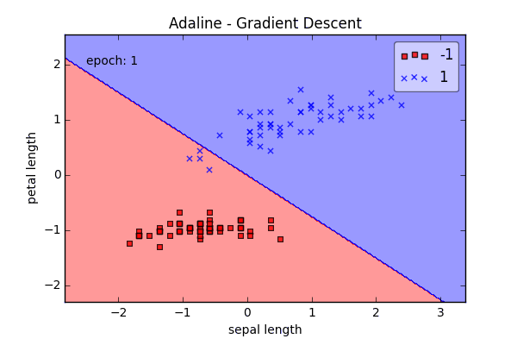
Example:
Our neural net’s job
is to figure out the correct line.
We know the true label of the points, and until the line correctly estimates most of the data, we keep changing the weights/bias on our neural net.
Notes:
information is most important to classifying the red fruit as an apple.

Slide 23
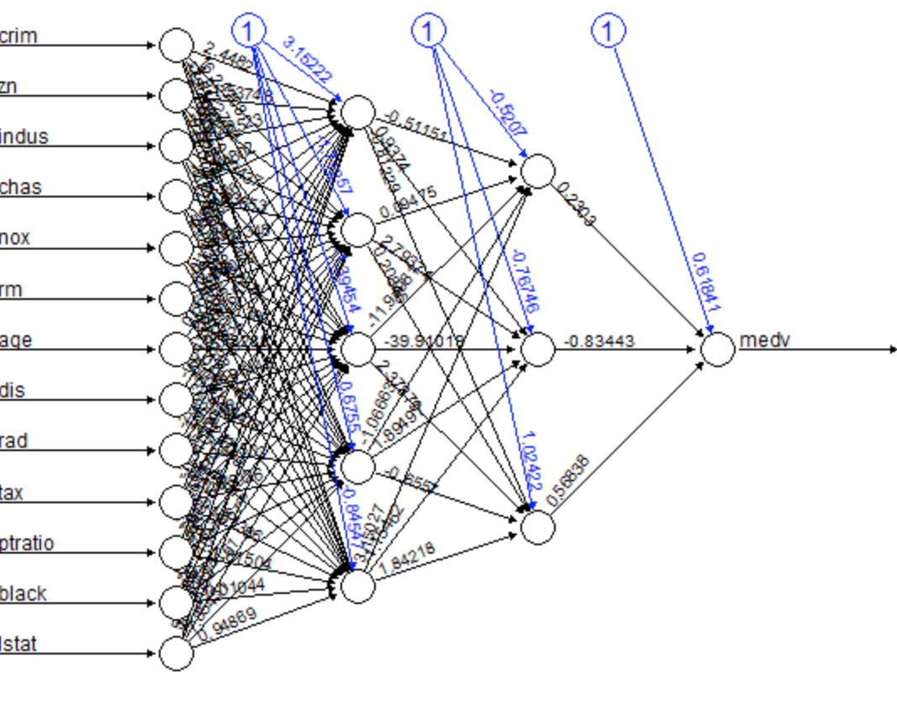
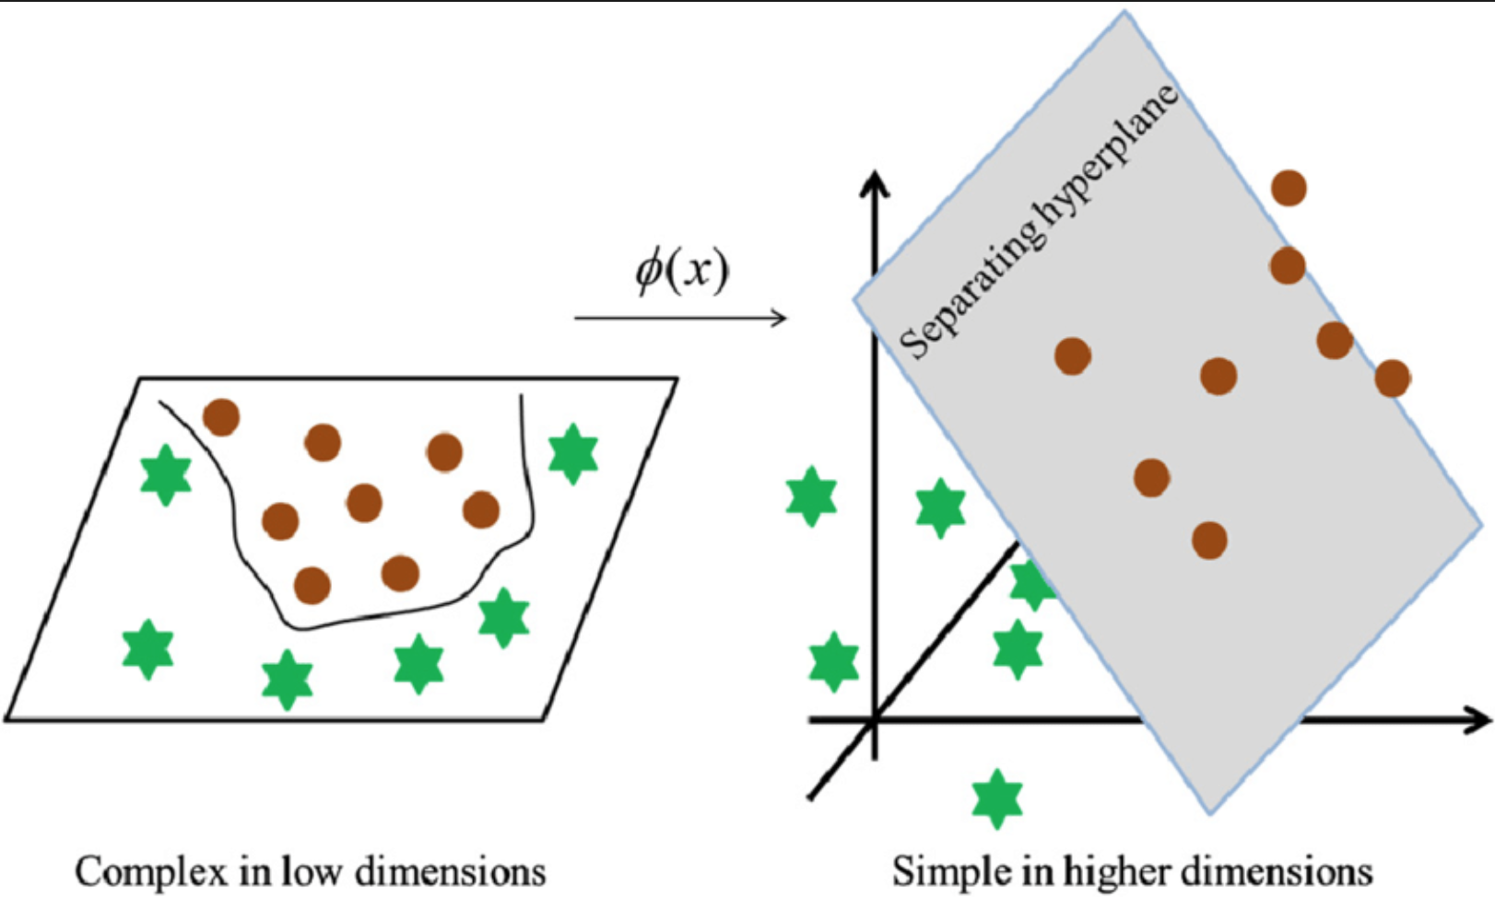
Neural Nets = More complicated versions of our one layer perceptron, built to handle all data, even non linear
…
σ^{n}
Notes:
ON A VERY HIGH LEVEL
Node just represent computation on input from the data with a set of coefficients/weights that amplify or dampen that input (assigning significance to features of the data)- just like how a neuron fires in the human brain when it encounters sufficient stimuli. -> e.g. which input is most helpful is classifying data without error? -> or what neurons information is most important to classifying the red fruit as an apple.
information is most important to classifying the red fruit as an apple.

Slide 24
How we add complexity to a Neural Net
Weights and Bias
Activation Function
Depth / Number of layer
Notes:
https://medium.com/coinmonks/the-mathematics-of-neural-network-60a112dd3e05

Slide 25
1. Weights / Bias
Notes:
https://medium.com/coinmonks/the-mathematics-of-neural-network-60a112dd3e05

Slide 26
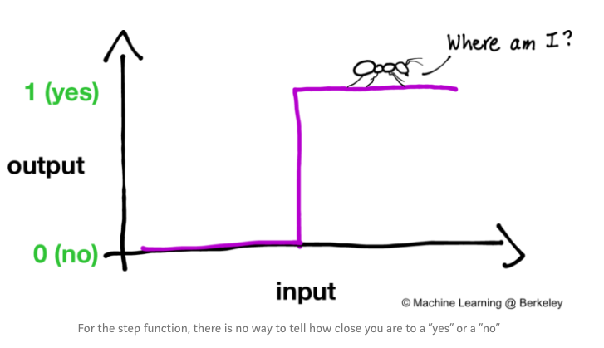
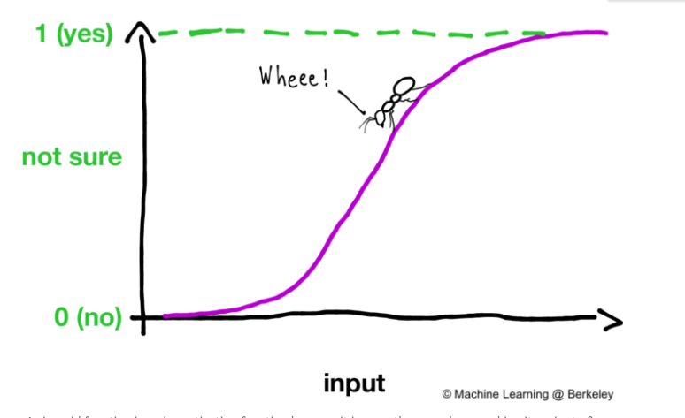
3. Different Activation Functions
Allow us to represent nonlinear classifications
Notes:
https://medium.com/@ml.at.berkeley/machine-learning-crash-course-part-3-4a5bfd72294a

Slide 27
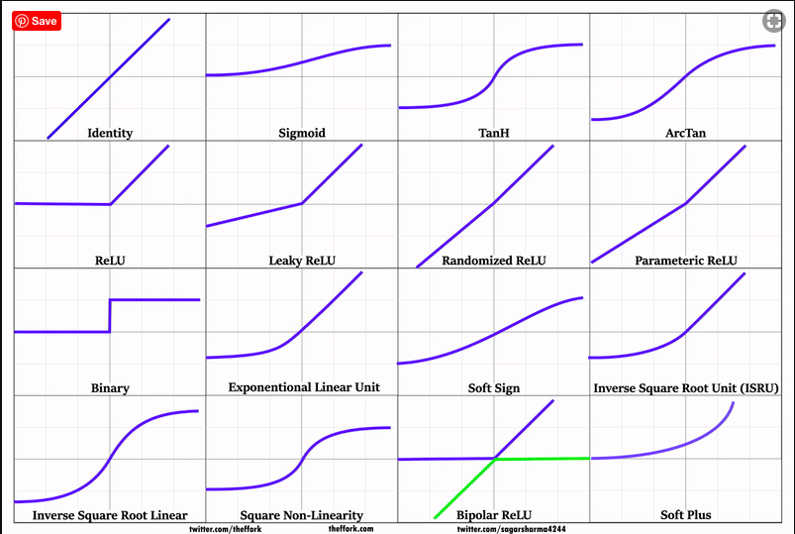
3. Different Activation Functions
Allow us to represent nonlinear classifications
Notes:
https://medium.com/coinmonks/the-mathematics-of-neural-network-60a112dd3e05

Slide 28
3a. Depth / Layers
Notes:
https://medium.com/coinmonks/the-mathematics-of-neural-network-60a112dd3e05

Slide 29
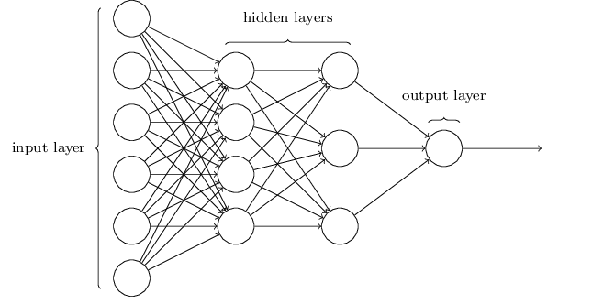
3b. Some vocab regarding depth -
Hidden Layer = non input / output layer
Maybe we want to apply multiple activation functions
Notes:
https://medium.com/coinmonks/the-mathematics-of-neural-network-60a112dd3e05

Slide 30

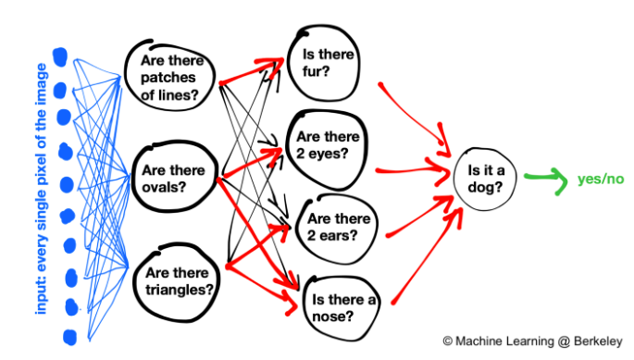
Putting it all together:
How do we recognize doge??
Notes:
https://medium.com/@ml.at.berkeley/machine-learning-crash-course-part-3-4a5bfd72294a

Slide 31
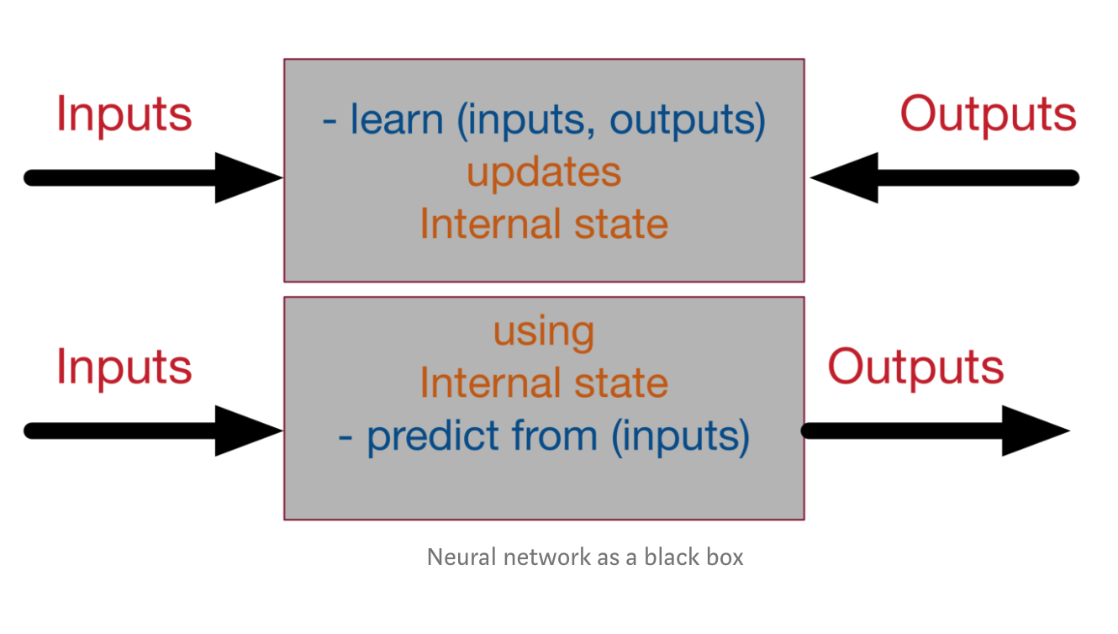
Putting it all together:
https://medium.com/datathings/neural-networks-and-backpropagation-explained-in-a-simple-way-f540a3611f5e
Notes:
https://medium.com/@ml.at.berkeley/machine-learning-crash-course-part-3-4a5bfd72294a

Slide 32
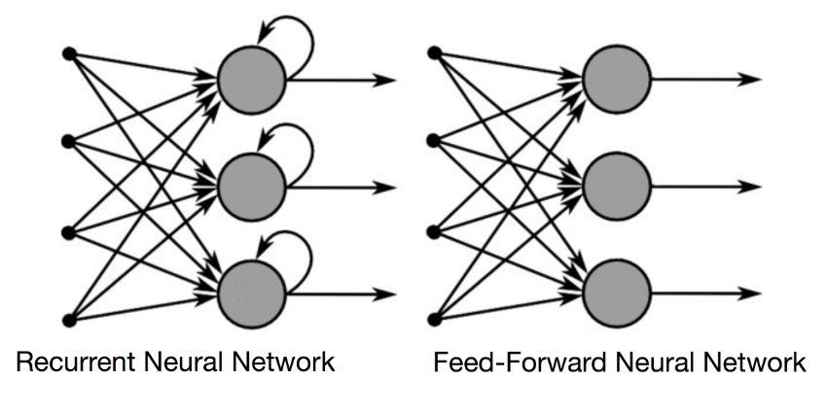
3c. More vocab:
Recurrent Neural Nets - RNN
So far we have only looked at feedforward neural networks that only feed data in one direction, but we can also have loops
Notes:
https://medium.com/coinmonks/the-mathematics-of-neural-network-60a112dd3e05

Slide 33
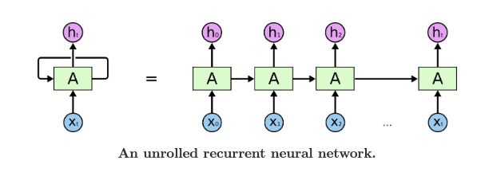
3c. More vocab:
Recurrent Neural Nets - RNN
A recurrent neural network can be thought of as multiple copies of the same network, each passing a message to a successor. Consider what happens if we unroll the loop:
Notes:
https://medium.com/coinmonks/the-mathematics-of-neural-network-60a112dd3e05
https://inst.eecs.berkeley.edu/~cs188/su19/assets/notes/note09.pdf

Slide 34
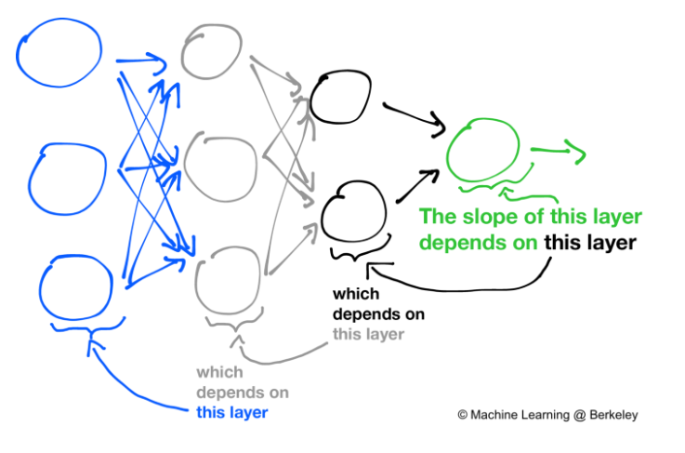
3c. More vocab: RNN uses backpropagation
For your reference: Backpropagation – When we define a neural network, we assign random weights and bias values to our nodes. Once we have received the output for a single iteration, we can calculate the error of the network. This error is then fed back to the network along with the gradient of the cost function to update the weights of the network. These weights are then updated so that the errors in the subsequent iterations is reduced. This updating of weights using the gradient of the cost function is known as back-propagation.
In back-propagation the movement of the network is backwards, the error along with the gradient flows back from the out layer through the hidden layers and the weights are updated.
Notes:
https://medium.com/coinmonks/the-mathematics-of-neural-network-60a112dd3e05
https://inst.eecs.berkeley.edu/~cs188/su19/assets/notes/note09.pdf
https://medium.com/@ml.at.berkeley/machine-learning-crash-course-part-3-4a5bfd72294a

Slide 35
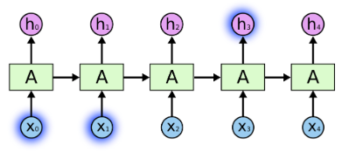
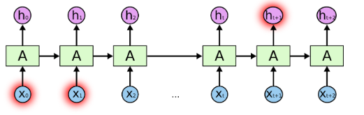
LSTM - Long Short Term Memory Networks
A special kind of RNN built to handle “long term dependencies:
Example: “the clouds are in the sky,”
VS: “I grew up in France… I speak fluent French.”

Slide 36
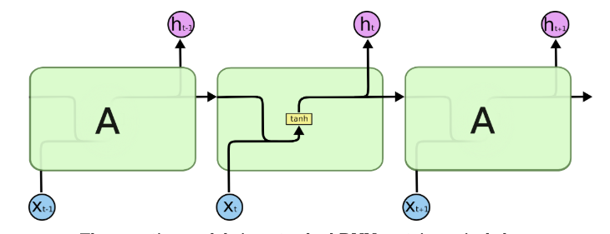
LSTM
Basic RNN = Neural Net with single layer with tanh activation fn

Slide 37
LSTM
Much more detailed explanation can be found here: http://colah.github.io/posts/2015-08-Understanding-LSTMs/ but its too much for us to cover in the time we have
Notes:
In the above diagram, each line carries an entire vector, from the output of one node to the inputs of others. The pink circles represent pointwise operations, like vector addition, while the yellow boxes are learned neural network layers. Lines merging denote concatenation, while a line forking denote its content being copied and the copies going to different locations.

Slide 38
Our Project
Link to Jupyter Notebook

Slide 39
Week 3: intro info
magenta.music has several Machine Learning models, each with different strengths. All models are built with Tensorflow, so they will run faster if you can run them on a GPU. Here are some of the most popular ones:
MelodyRNN - you give it a NoteSequence, and it continues it in the style of your original NoteSequence.
MusicVAE - generates brand new NoteSequences or interpolates between two sequences.
Onsets and Frames -- transcribes piano audio

Slide 40
Magenta library = RNN
https://magenta.tensorflow.org/2016/06/10/recurrent-neural-network-generation-tutorial
The Magenta library uses data to learn a probability distribution over the next notes given all the previous notes.
Usually models to generate new things are unsupervised (samples but no labels), but this allows us to generate “labels”/”note names” from any dataset of music and nothing else
Your audience will listen to you or read the content, but won’t do both.

Slide 41
Week 3: tips 4 how to train data
As with any ML model, there will be certain settings you can adjust that might yield better results. With Melody RNN, you can configure the number of steps the new sequence will be, as well as the temperature of the result -- the higher the temperature, the more random (and less like the input) your sequence will be. You can play around with these values and see how the resulting sequences are different:
The file doesn't need to be monophonic, but it does need to have at least 1 track that is monophonic so our melody extractor can find something that looks like a melody. There's a bit more information about how this works here:

Slide 42
Week 3: Steps
Now that we know how to use NoteSequences, adding some basic Machine Learning is a continuation of that. The pattern for using any of these models is:
Load magenta.music (which we already know how to do)
Create a model from a downloaded checkpoint (i.e. where the weights, or the encoding, of the model lives)
Ask the model to do something.

Slide 43
Week 3: Steps continued
Intialize model: melody RNN sequence generator
You’ll ['basic_rnn'](checkpoint=None, bundle=bundle)
Train your model with:
sequence = melody_rnn.generate(input_sequence, generator_options)
Try to figure out what “input_sequence” and “generator_options” should be.
Visualize your model with
mm.plot_sequence(sequence)
mm.play_sequence(sequence, synth=mm.fluidsynth)

Slide 44
Demo
Link to Jupyter Notebook if there is time….

Slide 45
Summary
What we did this week
Neural nets
LTSM
What you need to do next
Train that model!
Resources
Office hours:
Links on next slide

Slide 46
Resources
Links
Neural nets - https://medium.com/@ml.at.berkeley/machine-learning-crash-course-part-3-4a5bfd72294a
RNN - http://colah.github.io/posts/2015-08-Understanding-LSTMs/
LTSM
https://youtu.be/WCUNPb-5EYI
Office hours
Things
Feel free to slack/FB message us as always :)

Slide 47
INSTRUCTIONS FOR USE
EDIT IN GOOGLE SLIDES
Click on the button under the presentation preview that says "Use as Google Slides Theme".
You will get a copy of this document on your Google Drive and will be able to edit, add or delete slides.
You have to be signed in to your Google account.
EDIT IN POWERPOINT®
Click on the button under the presentation preview that says "Download as PowerPoint template". You will get a .pptx file that you can edit in PowerPoint.
Remember to download and install the fonts used in this presentation (you’ll find the links to the font files needed in the Presentation design slide)
More info on how to use this template at www.slidescarnival.com/help-use-presentation-template
This template is free to use under Creative Commons Attribution license. You can keep the Credits slide or mention SlidesCarnival and other resources used in a slide footer.

